Slide 1



DAYANANDA SAGAR UNIVERSITY
SCHOOL OF ENGINEERING
Department of CSE (Data Science)
CAPSTONE PHASE -I Review 1
Hybrid Piezo-Solar Smart Pad with Wheel-Embedded Receiver for Sustainable EV Charging
UNDER THE SUPERVISION
Prof. Manjula M
Assistant Professor
Prof. Kishore Malakar
Assistant Professor
PRESENTED BY:
HARSHITA JEETENDRA BHUTE- ENG22DS0003
JANARDHAN K S – ENG22DS0004
R SINDHU- ENG22DS0010
VIRIKA OLIVIA SOANS- ENG22DS0024

Slide 2

OVERVIEW
Abstract
Introduction
Objective
Scope of Work
Problem Statement
State of the Art work (Literature survey)
Proposed Solution
Methodology
Expected outcome
Conclusion
References

Slide 3
ABSTRACT
Electric Vehicles (EVs) are emerging as a sustainable alternative to conventional fuel-based transportation, offering advantages like reduced emissions and lower running costs. However, their adoption is slowed by challenges in charging infrastructure. Most EVs depend on grid-based charging, which increases demand on power networks and raises operational costs. Solar-based charging is eco-friendly but limited by weather and time of day, while large-scale alternatives often remain expensive to implement. Due to these limitations, only a moderate ratio of people prefer EVs compared to traditional vehicles, despite their long-term benefits. This project explores a hybrid renewable approach to overcome these barriers and support wider EV adoption.

Slide 4
INTRODUCTION
Electric Vehicles (EVs) are vital for a sustainable future, but their charging infrastructure faces challenges such as high costs, grid dependency, and unreliable renewable solutions. Solar energy alone is intermittent, and road-integrated chargers are expensive to deploy.
This project presents a Hybrid Piezo-Solar Smart Pad that combines solar panels and piezoelectric sensors to harvest energy from sunlight and vehicle movement. An ESP32-based IoT system monitors and manages charging, while AI-powered analytics ensure safety and efficiency.
The result is a cost-effective, modular, and sustainable EV charging solution suitable for campuses, depots, and smart cities.

Slide 5

Objective
Scope of work
The project focuses on developing a prototype charging hub with hybrid smart pads and wheel-embedded receivers.
Deliverables include:
Hybrid renewable energy harvesting pad.
IoT-based monitoring and control.
Secure authentication for vehicles (NFC).
AI anomaly detection for predictive safety.
Analytics dashboards and automated billing.
The scope is limited to small EV/e-bike scale demonstrations, with large-scale deployment considered future work.
To design hybrid smart pads integrating solar panels and piezoelectric sensors.
To build a wheel-embedded receiver module for safe energy transfer.
To implement ESP32 IoT monitoring with safety cutoffs.
To integrate a Python + SQL backend for anomaly detection and billing.
To develop Power BI dashboards for visualization and predictive maintenance.

Slide 6
PROBLEM STATEMENT
EV charging faces issues like high costs, grid dependency, and limited reliability. Solar-only solutions are weather-dependent, and road-integrated systems are expensive. A cost-effective, modular, and sustainable hybrid charging system is needed for continuous, reliable, and renewable energy-based EV charging.
High dependency on grid electricity increases cost and reduces sustainability.
Solar power alone is unreliable during cloudy weather or nighttime.
Road-integrated charging solutions are costly and hard to deploy at scale.
Lack of retrofit-compatible and modular systems limits adoption.

Slide 7
State of the Art-work
Author’s Name / Paper Title | Conference / Journal Name and Year | Technology | Results shared by author | Insights
V. Ramakrishnan, D. Savio A., B.C., N. Rajamanickam, H. Kotb, A. Elrashidi, W. Nureldeen – “A Comprehensive Review on Efficiency Enhancement of Wireless Charging System for the Electric Vehicle Applications” | 2024 IEEE Access, Vol. 12, Institute of Electrical and Electronics Engineers (IEEE), USA, 2024 | Efficiency Enhancement in WPT, Impedance Matching, Compensation, Multi-Coil | • Surveyed factors affecting PTE (coil geometry, coupling, misalignment). • Discussed active/passive impedance matching and compensation methods (SS, SP, LCC, LCL). • Multi-coil and multi-transmitter prototypes achieved >90–95% efficiency. | • Impedance matching and hybrid compensation are key for efficiency. • Multi-coil systems improve misalignment tolerance. • Suggests research on dynamic charging, interoperability, and cost-effective designs
C.S. Banothu, S.R. Gorantla, R.V.B. Attuluri, G.R. Evuri – “Impacts of Wireless Charging System for Electric Vehicles on Power Grid” | 2024 e-Prime – Advances in Electrical Engineering, Electronics and Energy, Elsevier Ltd., Amsterdam, Netherlands, 2024 | Wireless Fast Charging (WFC) & Grid Integration | • Analyzed fast charging (>20 kW) on MV distribution feeders in India. • Identified voltage swings, harmonic distortion, and instability. • Proposed RES integration and EV aggregators for stability. | • Highlights grid-level impacts of WFC. • Suggests coordinated planning, V2G, and RES as mitigation strategies.
A. Kumar, R. Sridhar, et al. – “Hybrid Compensation Based Efficient Wireless Charging System Design With Solar Photovoltaic Interface Toward Sustainable Transportation” | 2024 IEEE Transactions on Transportation Electrification, Institute of Electrical and Electronics Engineers (IEEE), USA, 2024 | Hybrid Compensation & Solar-PV Integrated WPT | •Proposed hybrid LCC-S compensation with PV interface. • Achieved higher efficiency and stable operation under variable load. • Demonstrated renewable-powered EV charging. | • Integration of PV with WPT reduces grid dependency. • Hybrid compensation boosts efficiency and reliability. • Supports sustainable EV transport.

Slide 8
R. Rahul kumar, N. Mehta, et al., “Model-Free Predictive Control and Modified Multi-Phase Shift PWM Technique for a Semi-Dynamic Wireless EV Charging System” | 2023 International Conference on Renewable Energy and Power Electronics (REPE), Singapore | Model-Free Predictive Control (MFPC), PWM, Semi-Dynamic WPT | • Proposed MFPC + modified PWM achieving 24–28 ms fast response. • Ensured constant voltage, ZVS/ZCS operation. • Experimental prototype validated for semi-dynamic lanes. | • Outperforms conventional MPC/PI. • Enables communication-free frequency tuning. • Practical for semi-dynamic charging pads.
A. Sagar, A. Kashyap, M. Azimi Nasab, S. Padmanaban, M. Bertoluzzo, A. Kumar, F. Blaabjerg – “A Comprehensive Review of the Recent Development of Wireless Power Transfer Technologies for EV Charging Systems” | 2023 IEEE Access Journal, Institute of Electrical and Electronics Engineers (IEEE), USA, 2023 | Wireless Power Transfer (WPT) | • Classified WPT: inductive, capacitive, resonant. • Showed magnetic resonance + shielding improved PTE. • CPT achieved 88% efficiency at 590 W. | • Identified gaps: EMF safety, interoperability, misalignment tolerance. • CPT is a low-cost alternative to IPT.
R. Ramadoss, B. Alekhya, G. Abinaya, et al., “Research Insights on Recent Power Converter Topologies and Control Strategies for Wireless EV Chargers” | 2023 IEEE International Students’ Conference on Electrical, Electronics and Computer Science (SCEECS), Bhopal, India | Power Converters, Control Strategies, WPT | • Reviewed DC-DC, AC-DC, multilevel converters. • Highlighted control methods (PI, sliding-mode, MPC, PWM). • Trade-offs in efficiency vs. complexity. | • Provides taxonomy of converters. • Emphasizes resonant, soft-switching, and adaptive controls.

Slide 9
H. Shahin, M. Islam, et al., “A Comprehensive Analysis Integrating Renewable Energy Sources with Wire/Wireless EV Charging Systems” | 2023 International Conference on Intelligent Communication and Computational Techniques (ICCT), Jaipur, India | Renewable Energy Integration, PV + WPT, Compensation | • Analyzed PV integration with wired/wireless charging. • Recommended SS compensation, MPPT, hybrid PV–battery. • Showed RES reduces grid stress. | • Demonstrates PV-powered EV stations. • Highlights compensation topologies for efficiency.
R. Saklani, A. Singh, et al., “Navigating the Challenges of EV Integration and Demand-Side Management for India’s Sustainable EV Growth” | 2023 International Conference on Power, Energy and Smart Grid (PESG), India | Demand-Side Management (DSM), Smart Grid, EV Integration | • Presented DSM models: time-of-use pricing, V2G, RES coordination. • Proposed India-specific load frameworks. | • Underlines DSM’s role in developing economies. • Policy-driven adoption critical in India.
Y. Shanmugam, R. Narayanamoorthi, P. Vishnuram, M. Bajaj, K.M. Aboras, P. Thakur, Kitmo – “A Systematic Review of Dynamic Wireless Charging System for Electric Transportation” | 2022 IEEE Access Journal, Institute of Electrical and Electronics Engineers (IEEE), USA, 2022 | Dynamic Wireless Charging (DWC) | • Reviewed couplers, compensation networks, inverter topologies. • Demos: KAIST OLEV buses, ORNL 120 kW, KRRI 1 MW train. • Efficiency up to 97%. | • DWC reduces battery size and extends EV range. • Challenges: misalignment, instability, renewable integration.
A. Mahesh, B. Chokkalingam, and L. Mihet-Popa, “Inductive Wireless Power Transfer Charging for Electric Vehicles—A Review,” | 2021 IEEE Access, Vol. 9, IEEE, USA, 2021 | Model-Free Predictive Control (MFPC), PWM, Semi-Dynamic WPT | • Reviewed early IPT methods for EVs. • Discussed SS, SP, LCC, and resonant compensation. • Addressed coil design, misalignment, and EMI safety. | • Provided foundation for later WPT/DWC works. • Emphasized efficiency vs. coil misalignment trade-off. • Highlighted safety and standardization needs.

Slide 10
Proposed Solution
To overcome the limitations of existing EV charging systems, this project proposes a Hybrid Piezo-Solar Smart Pad with Wheel-Embedded Receiver that combines solar energy and piezoelectric power harvesting.
Solar panels generate clean energy during the day, while piezoelectric sensors harvest energy from vehicle wheel pressure, enabling 24×7 charging.
An ESP32 IoT controller handles real-time monitoring, safety cutoffs, and system control.
Energy transfer occurs via a wheel-embedded receiver module, ensuring retrofit compatibility with existing EVs.
A Python + SQL backend performs anomaly detection and manages billing, while Power BI dashboards provide insights into energy usage and predictive maintenance.
This solution delivers a modular, reliable, and sustainable EV charging infrastructure with strong potential for scalability and patentability.

Slide 11
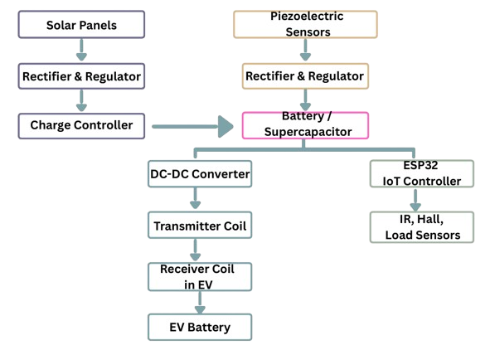
Methodology
The system integrates renewable energy harvesting and IoT-based monitoring for wireless EV charging. Solar panels provide stable DC power through a regulator, while piezoelectric sensors embedded in the road generate AC that is converted using a full-wave rectifier and filter, then regulated for storage.
Both energy sources feed into a charge controller, which safely manages a battery or supercapacitor bank.
Stored energy is boosted by a DC-DC converter and passed to a resonant inverter that drives the transmitter coil, creating a high-frequency magnetic field for wireless power transfer.
The receiver coil in the EV captures this energy, rectifies it, and channels it to the EV battery via its BMS.
To ensure safe and efficient operation, sensors such as IR (vehicle detection), Hall effect (coil current), and load/current sensors monitor the process.
An ESP32 IoT controller, powered from the storage battery, collects sensor data, regulates control signals, and transmits real-time performance metrics over Wi-Fi to a cloud server and dashboard for analysis and user monitoring.
Hardware Methodology

Slide 12
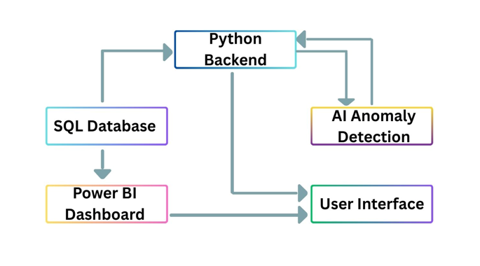
Methodology
The ESP32 transmits real-time sensor and energy data via Wi-Fi to a Python backend, which cleans, preprocesses, and formats the information before storing it in a structured SQL database.
An AI anomaly detection module runs on this data to identify unusual patterns such as faults, abnormal demand, or predictive maintenance needs.
On the visualization side, a Power BI dashboard connected to the database provides administrators with analytics on total energy harvested, charging sessions, and system alerts, while a user-facing mobile/web app communicates through the backend API to show EV owners their charging status, energy delivered, and billing details in an accessible interface.
Software Methodology

Slide 13
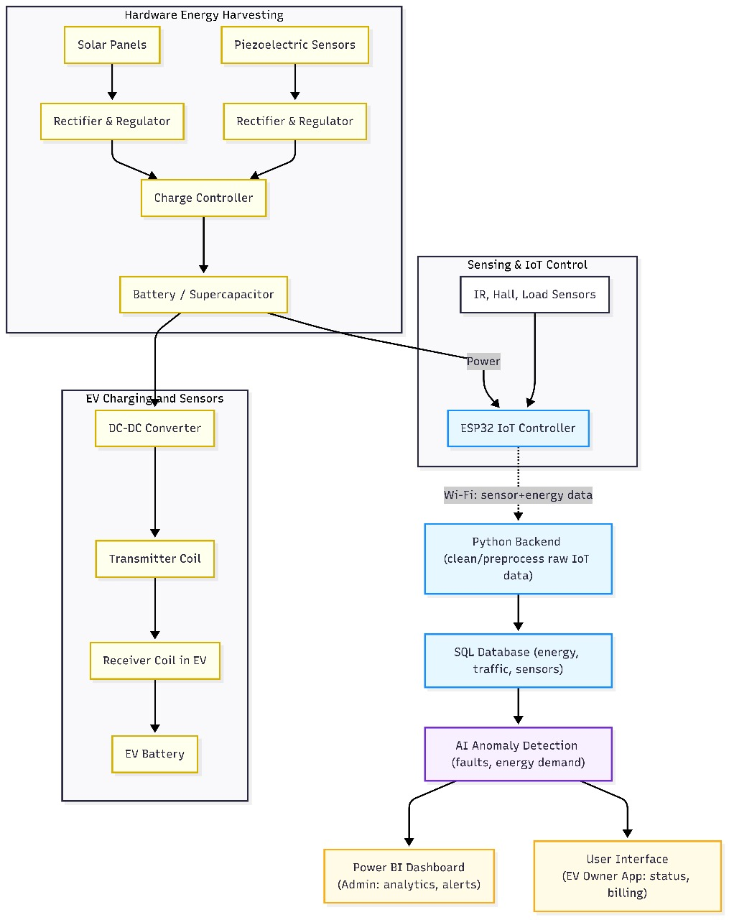
Integrated Methodology

Slide 14
Expected Outcome
A working prototype of a Hybrid Piezo-Solar Smart Pad that provides continuous EV charging using solar and piezoelectric energy.
An IoT-based monitoring system with real-time data collection, safety cutoffs, and energy management.
A functional wheel-embedded receiver module for efficient energy transfer to EVs.
An integrated backend system for anomaly detection, automated billing, and predictive maintenance.
Interactive Power BI dashboards showing energy usage, charging analytics, and system health.
A cost-effective, modular, and sustainable solution suitable for small-scale EVs (like e-bikes), with potential for future large-scale deployment and patent development

Slide 15
Conclusion
This project successfully proposes a Hybrid Piezo-Solar Smart Pad with Wheel-Embedded Receiver to address the challenges of EV charging infrastructure. By combining solar and piezoelectric energy harvesting, along with IoT-based monitoring and AI-powered analytics, the system ensures reliable, sustainable, and cost-effective EV charging.
The prototype demonstrates a modular design suitable for campuses and smart cities, promoting reduced grid dependency and eco-friendly energy use. It offers strong potential for scalability, retrofit compatibility, and future patent opportunities, contributing to the growth of sustainable transportation solutions.

Slide 16
References
https://ieeexplore.ieee.org/abstract/document/10473997
https://www.sciencedirect.com/science/article/pii/S2772671124001426
https://ieeexplore.ieee.org/abstract/document/10771773
https://ieeexplore.ieee.org/abstract/document/9970736
https://ieeexplore.ieee.org/abstract/document/10198186
https://ieeexplore.ieee.org/abstract/document/10771773
https://ieeexplore.ieee.org/abstract/document/10705693
https://ieeexplore.ieee.org/abstract/document/10689419
https://ieeexplore.ieee.org/abstract/document/10699341

Slide 17

THANK YOU!

